Slide 1

IT Project Financials
Cecil Eng Huang Chua
cecq8z@mst.edu

Slide 2
Outline
Preliminary Comments
Common Financial Arguments
  Payback Period
  Net Present Value
  Return on Investment

Slide 3
Preliminary Comments
Almost never a need to do financial analysis for decision making
In a financially justified IT project, the numbers should be blindingly obvious
If the project is borderline, it is not financially justified
  Most IT projects have underestimated costs and risks and overestimated benefits
  Choosing between projects

Slide 4
Why Financial Arguments
To justify a decision
To demonstrate we have been thorough in our thinking

Slide 5
In Reality
A lot of IT projects don’t make financial sense
IT is often a cost center
  It enables other aspects of the business
  Cost booked to IT, benefits booked to others
Asset Specificity
Nevertheless, IT is still strategically important
  Thus, justification is not through the finances

Slide 6
Asset Specificity
The value of an asset is contingent on some other asset
Fuel pump monitoring system
Depends on the specific type of fuel pump
  If fuel pump technology changes, the monitoring system becomes worthless

Slide 7
What’s Really Important About Financials: Thinking
Money now is more important than money in the future
Choices are not yes/no
  Choose among alternatives
  Doing nothing is an alternative: The bank pays you interest if you do nothing
  There are different ways of paying for things: Buy vs lease
Money flows differently from work
Rules and regulations can make certain things worthwhile doing
  A loss-making project is a tax benefit

Slide 8
Outline
Preliminary Comments
Common Financial Arguments
  Payback Period
  Net Present Value
  Return on Investment

Slide 9
General Financial Thinking
I will make $10000 from this project next year
How much is this actually worth if I get 5% interest from the bank?
1.05 x Deposit= $10000
$9523.81
Implication: If I spend more than $9523.81 on this project, I am better off just putting the money in the bank

Slide 10
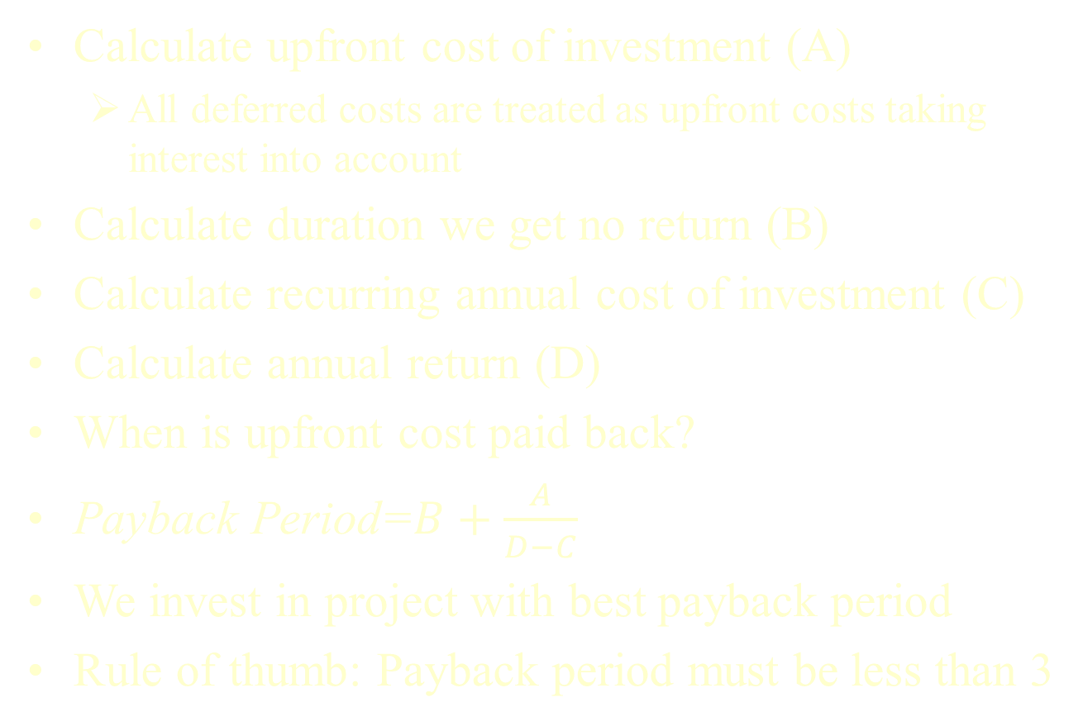
Payback Period
Calculate upfront cost of investment (A)
  All deferred costs are treated as upfront costs taking interest into account
Calculate duration we get no return (B)
Calculate recurring annual cost of investment (C)
Calculate annual return (D)
When is upfront cost paid back?
Payback Period=$B+\frac{A}{D−C}$
We invest in project with best payback period
Rule of thumb: Payback period must be less than 3

Slide 11
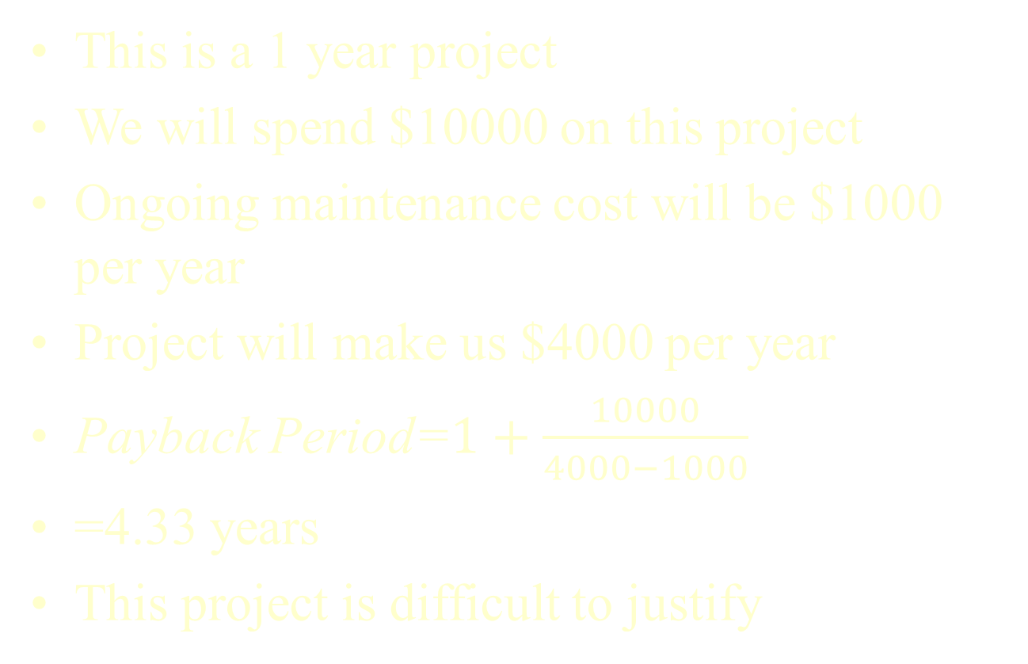
Example
This is a 1 year project
We will spend $10000 on this project
Ongoing maintenance cost will be $1000 per year
Project will make us $4000 per year
Payback Period=$1+\frac{10000}{4000−1000}$
=4.33 years
This project is difficult to justify

Slide 12
Net Present Value with Obsolescence (1)
Basically Payback Period including
  Interest Rate
  That the project has a limited shelf life

Slide 13
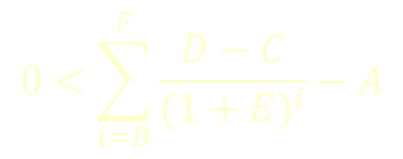
Net Present Value with Obsolescence (2)
Calculate upfront cost of investment (A)
Calculate duration we get no return (B)
Calculate recurring cost of investment (C)
Calculate annual return (D)
Calculate interest rate (E)
Calculate when investment will be obsolete (F)
This must be true:
$$0<\sum_{i=B}^{F}{\frac{D−C}{{(1+E)}^{i}}−A}$$

Slide 14
Example(1)
This is a 1 year project. The system will be condemned in 6 years
We will spend $10000 on the project
Ongoing maintenance costs will be $1000 per year
Project will make us $4000 per year
The interest rate is 5%

Slide 15
Example (2)
Year | From Previous Year | Cost | NPV of Cost | Return | NPV of Return | Total
0 | 0 | 10000 | 10000 | 0 | 0 | -10000
1 | -10000 | 1000 | 952.381 | 4000 | 3809.524 | -7142.86
2 | -7142.857143 | 1000 | 907.0295 | 4000 | 3628.118 | -4421.77
3 | -4421.768707 | 1000 | 863.8376 | 4000 | 3455.35 | -1830.26
4 | -1830.255912 | 1000 | 822.7025 | 4000 | 3290.81 | 637.8515
5 | 637.8515125 | 1000 | 783.5262 | 4000 | 3134.105 | 2988.43
Demonstrates both strength and weakness of business case. Project will make money, but only in 4 years. Also, note how little money the project makes after 5 years.

Slide 16
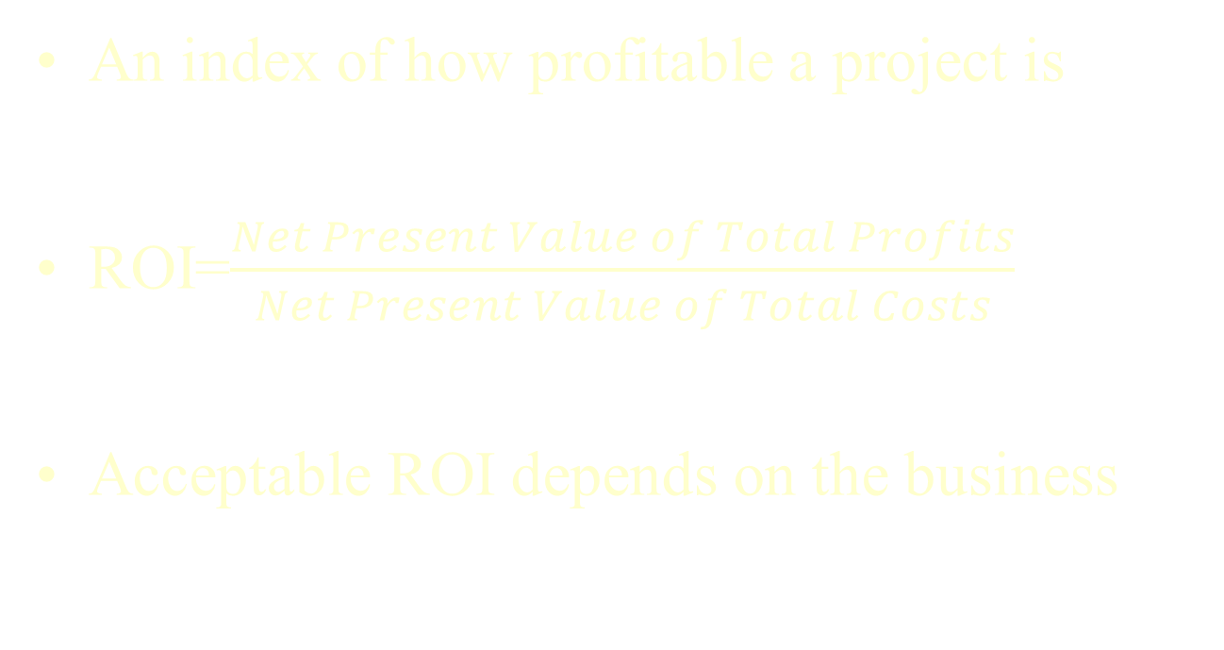
Return on Investment (ROI)
An index of how profitable a project is
ROI=$\frac{Net Present Value of Total Profits}{Net Present Value of Total Costs}$
Acceptable ROI depends on the business

Slide 17
ROI Example
2369.93/10000=0.2369
In most organizations, this isn’t a worthwhile investment.

Slide 18
Thinking About Rate of Return
Each organization has magic numbers
Hurdle Rate
  Typical rate of company’s projects
  Will not invest if lower
  Use this as interest rate
Weighted Average Cost of Capital
  Interest rate the company borrows at
  Will not invest if lower
  Use this as interest rate

Slide 19
Weird Things About Financial Analysis
The higher the interest rate, the less valuable any investment will be
  Because we can just put the money in the bank
If we spend money in the future, we spend less money
  We prefer to spend money later
If we make money in the future, we make less money
  We prefer to make money now
Taxes hurt our profits, but reduce our losses

Slide 20
Q&A

